Slide 1
SEP Customer UAT Testing
Oct 29th 2019
Martin Kerr
Stephanie Krus

Slide 2
Who we tested with
5 Business Owner / Senior Decision Makers @ Taylor McKenzie Lab in Glasgow

Slide 3
What we were trying to find out
We were interested in:
How stable SEP was before Beta release
Tease out a few areas that we still expect some minor issues
Brexit impact
Starting URL: https://se-qa-singleentrypoint.azurewebsites.net

Slide 4
Summary
The site is fairly stable and most things work quite well
The only real issue is that people are not expecting the Event Links to send them to another site (usually bgatway.com), and they can become lost. This is worse if they have to register for a MyBusinessID, as this is intense enough to break the sent trail.
The Company/Address lookup now works very well and got good feedback.
The only minor niggle left is when people select the wrong address and try to use it for a second time. It does not have a reset capability.
The homepage image was well received
The grey footer was viewed as a bit clunky but not really a problem

Slide 5
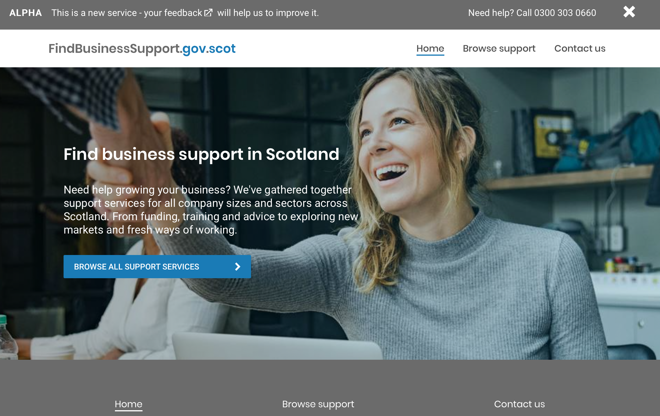
Home Page
The homepage image was well received.
The homepage was generally well received and everyone clicked the Blue CTA button and progressed into the site.
The homepage text was not as well received because of being a bit harder to read and viewed as not “Saying what it Does” clearly enough
There was some uncertainty about the site being just for startups or all companies

Slide 6
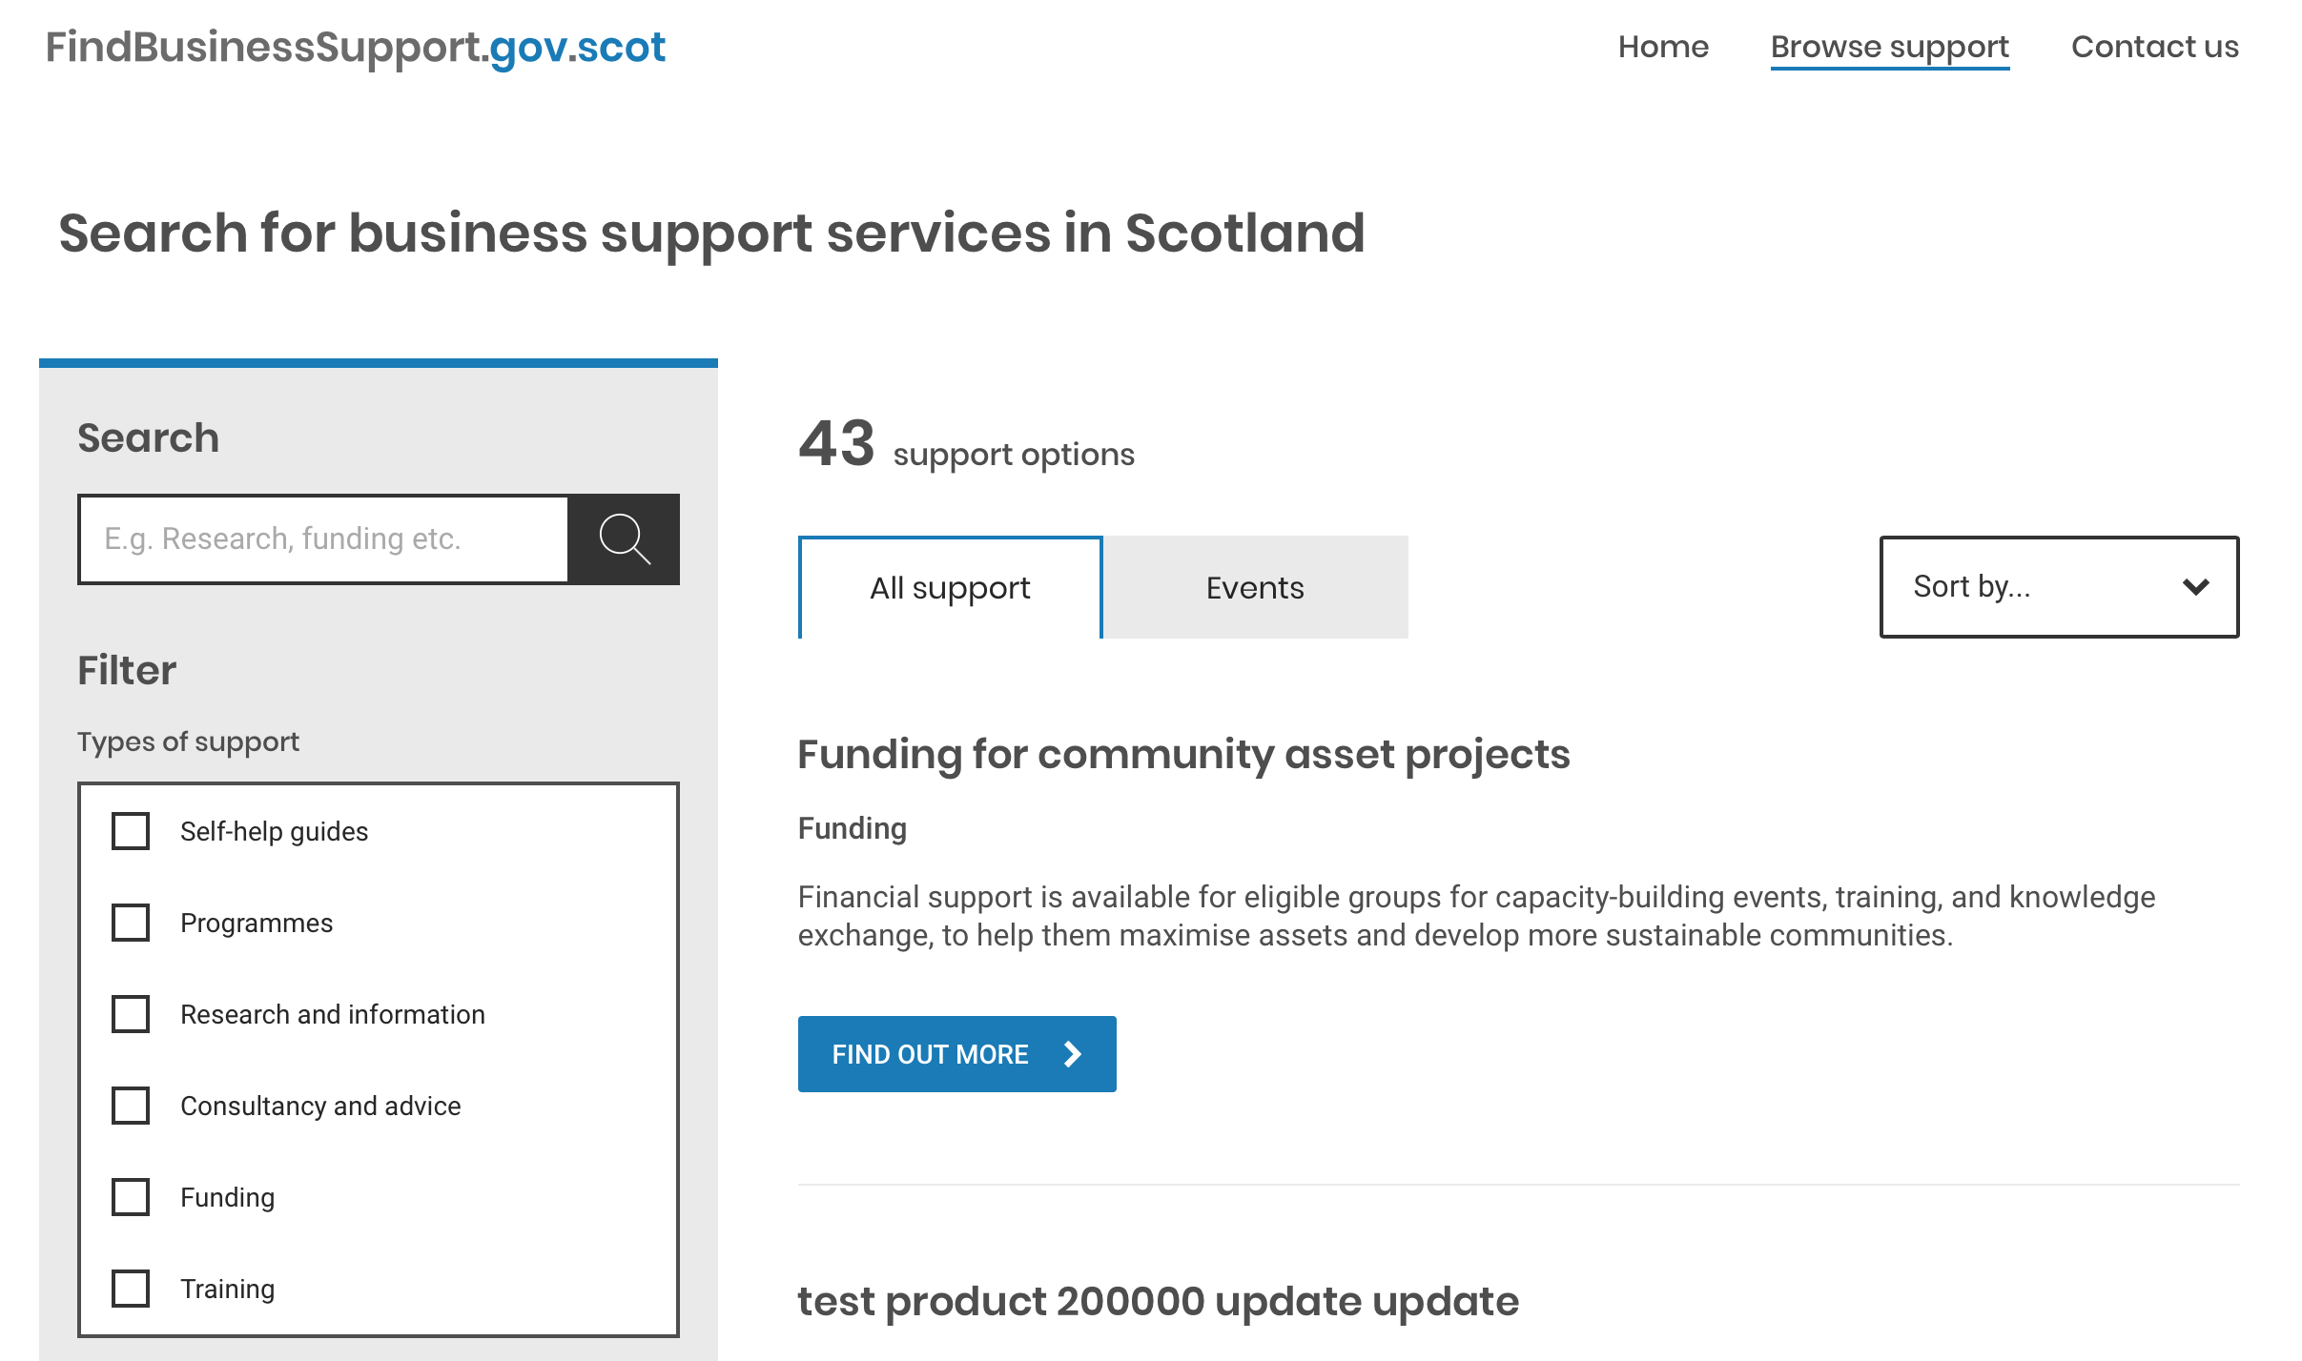
Support Listings
The service listing was well received.
It was perceived as being like “GOV.UK” which was good
Search and Filter being separated worked well.
Some people got mildly confused between the filter being OR instead of AND
The CTA was very clear
People were unsure about who delivered each thing

Slide 7
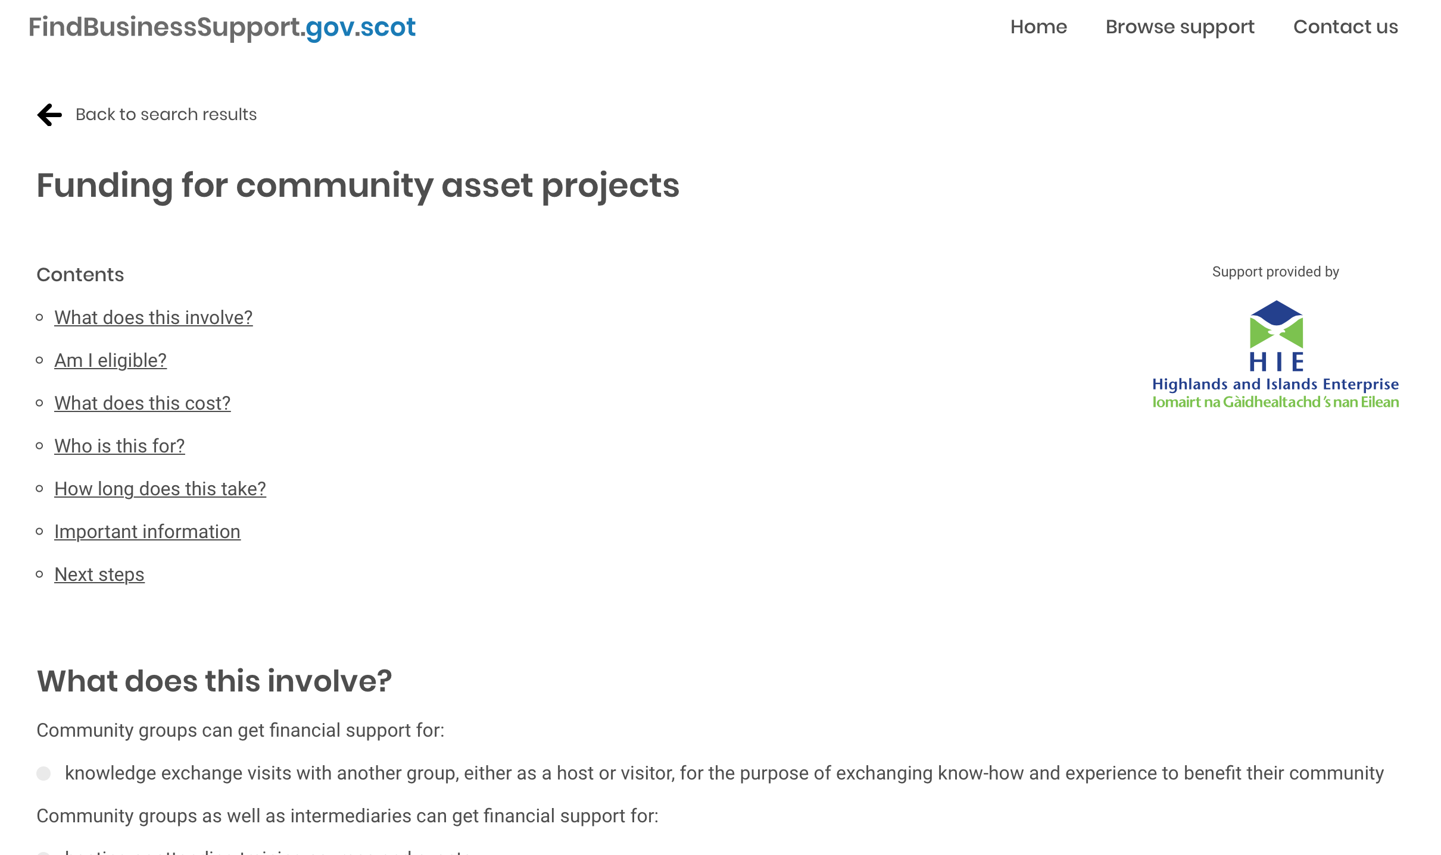
Individual Support Listing
It was perceived as being like “GOV.UK” which was good
The links at the top were well received
Cost & Eligibility were lauded for being near the top. Everyone commented on them being the first thing they would look at
The CTA was very clear (Blue Button at the bottom)
BUT
Some people were not expecting what looked like a CONTACT FORM.

Slide 8
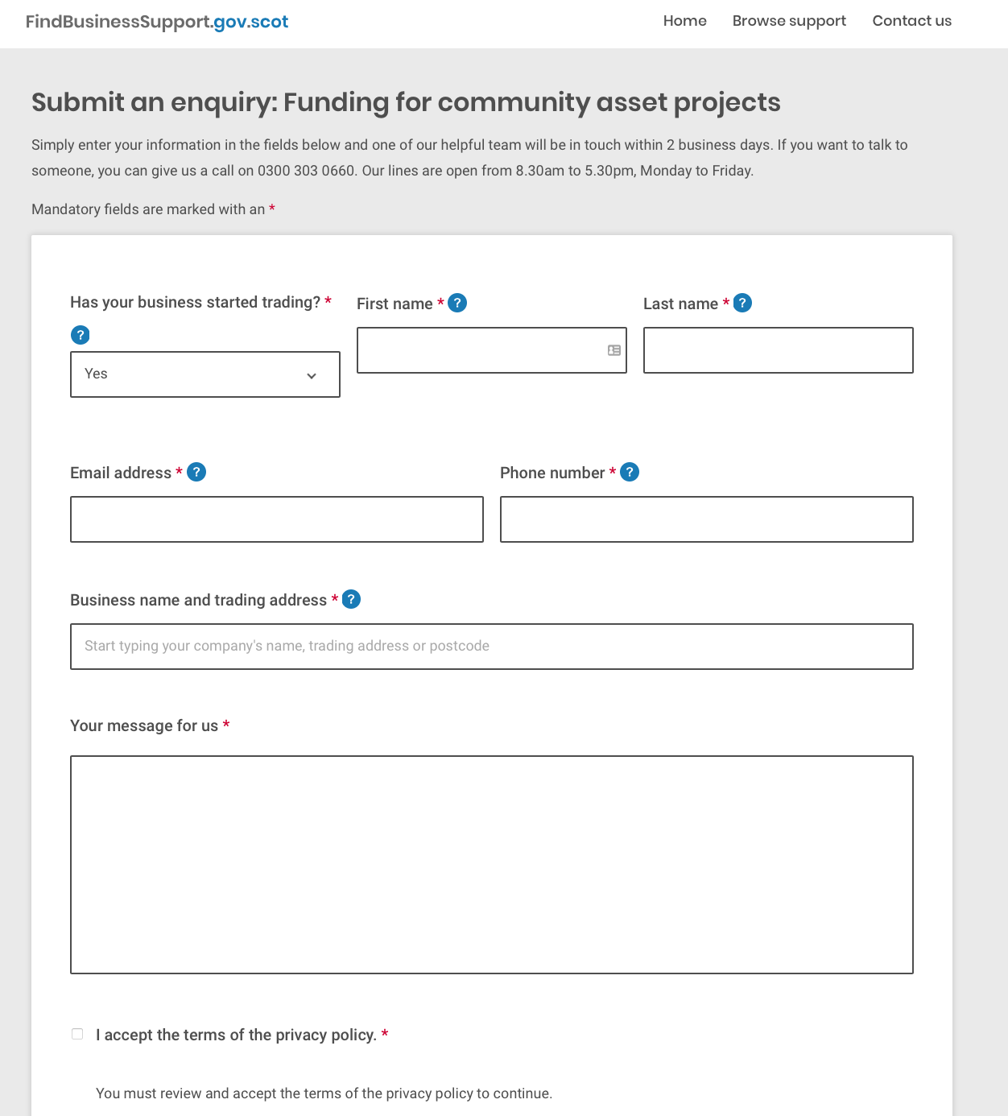
Submit an Enquiry
The brevity of the form was well received
The address lookup was also well received
Some people tried to use the company/address lookup a 2nd time and couldn’t

Slide 9
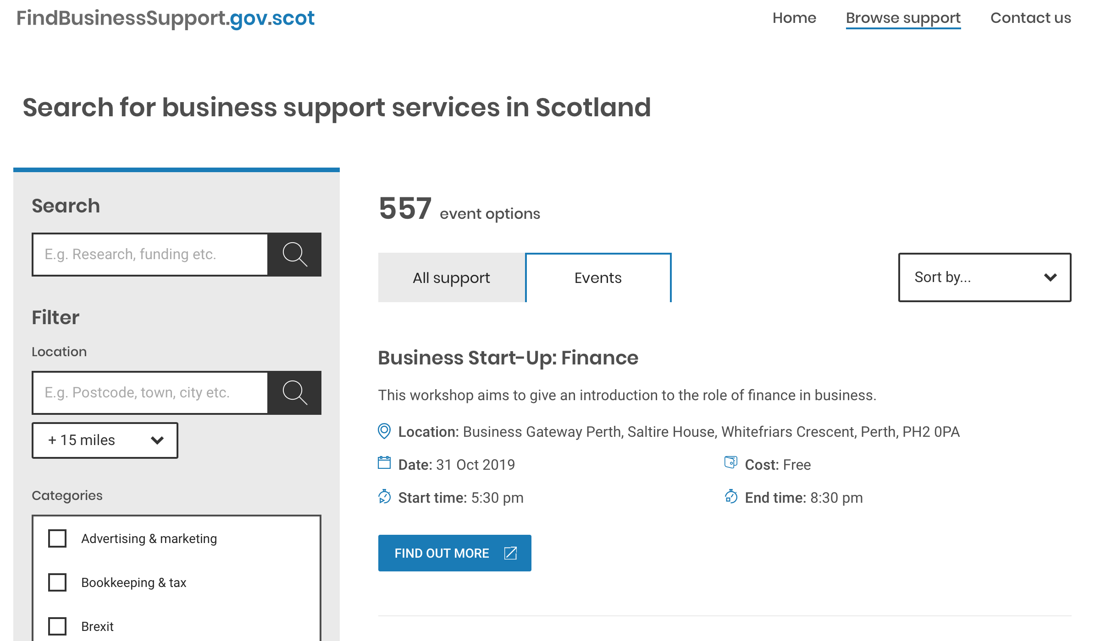
Event Listings
The events listing was well received.
The meta data under each event was appreciated as it meant that people did not have to go into each event to get the info
There was an issue with people being sent to another site to see the event details without them realizing what had happened OR expecting that to happen.
Suggestion: Make it more explicit that the CTA button takes you to another site

Slide 10
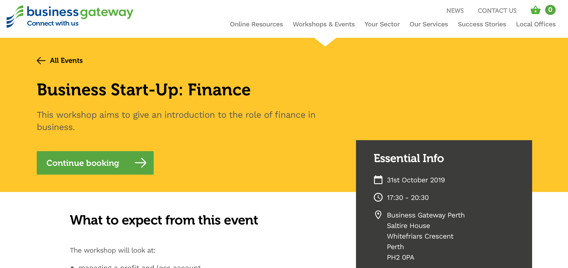
Individual Event Listing
The

Slide 11
SEP Feedback Quotes
Am I eligible and how much it costs. That’s what I am interested in.
When will this go live. It is interesting.
The homepage doesn’t scroll down?
I understand the need for this. It’s disjointed (business support landscape) , everyone is doing their own things. It’s difficult for people to know where to start.
It needs to be straight to the point. It’s overwhelming when you start (a business), so we need to get things that are straightforward.

Slide 12
Brexit
People are sick and tired of Brexit
Some have stockpiled and now face cashflow issues
They also face uncomfortable supplier relationships due to uneven demand patterns
Business Uncertainty is still the number one stated issue caused by Brexit

Slide 13
fin

